Slide 1
AntiSamy Java Introduction
Wang Wenjun
June 2011

Slide 2

Who am I?
Name Wang Wenjun(王文君)
EMail shanda.wang@gmail.com
Job HP Shanghai Engineering Lab
Side Job Roger Federer’s hot fan
Quote 博观而约取，厚积而薄发

Slide 3

Agenda
Story of Samy
How AntiSamy works?
Case study
Advanced topic

Slide 4


Part 1
Story of Samy

Slide 5

Story of Samy
Myspace is a social networking site(SNS), and you can setup your own profile.
Samy made one XSS-Worm in his own profile, which made his reader as the new XSS-worm source.

Slide 6
Attack theory of Samy Worm
Samy’s profile
friend¹ profile
friend² profile
friend² profile
friend¹ profile
friend² profile
Notes:
The process began when a Myspace.com user, going by the name of “Samy” placed Javascript code in his profile.
When other Myspace.com users would view Samy’s profile, the code would initiate a background request (via Ajax) to add Samy to that user’s friend list – bypassing the typical approval process.
The next step in the process made the code self-replicating. This involved parsing out the code being executed and copying it to the viewing user’s profile. The process would then repeat at the next view of the newly infected user’s profile.
This can cause a DOS(Deny of Service) attack because of the exponential growth of the attacker’s friend list.
For more technical details info, please refer to this url: http://namb.la/popular/tech.html
For the interview with Samy, please refer to this url: http://blogoscoped.com/archive/2005-10-14-n81.html

Slide 7
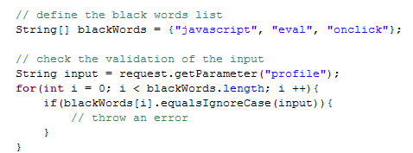

Why MySpace is wrong?
It uses a black word list, but you can’t foresee all the possible attack ways.

Slide 8
User needs to input HTML code?
SNS needs to provide a customized profile
Rich editor to some enterprise application
Community site like ebay allow public list
Yes, the need HTML

Slide 9
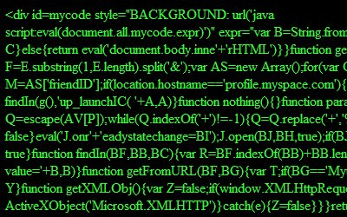

It is your turn, AntiSamy!

Slide 10
Part 2
How AntiSamy work

Slide 11
AntiSamy introduction
An HTML input validation API
It uses a white word list(defined in policy file)
Dirty input
Policy file
Clean output

Slide 12
Dive to AntiSamy (1) - Sanitize
<body>
<div id="foo">
<img src="javascript:xss()">
</div>
<b><u>
<p style="expression(…) ">
samy is my hero</p>
</u></b>
<a href="http://www.google.com">
Google</a><script src="hax.js">
</script>
body
div
b
a
script
id=foo
href=…
src=hax.js
img
u
(text)
src=javascript:xss()
Google
p
style=expression(…)
(text)
samy is my hero
Notes:
NekoHTML is a simple HTML scanner and tag balancer that enables application programmers to parse HTML documents and access the information using standard XML interfaces. The parser can scan HTML files and "fix up" many common mistakes that human (and computer) authors make in writing HTML documents. NekoHTML adds missing parent elements; automatically closes elements with optional end tags; and can handle mismatched inline element tags.
For more info about NekoHTML, please refer to this url: http://nekohtml.sourceforge.net/

Slide 13
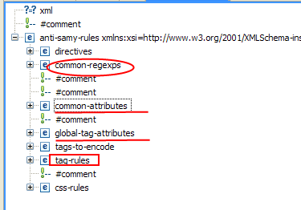
Dive to AntiSamy (2) - validate
Tag
<tag-rules>
Attribute
<common-attributes>
Expression
<common-regexps>
<global-tag-attributes>
Notes:
Step the DOM tree, and validate all nodes with the policy file

Slide 14
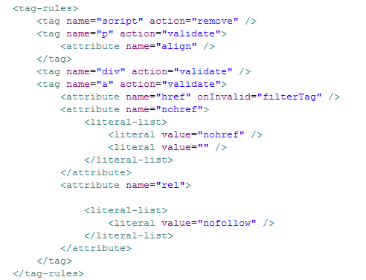
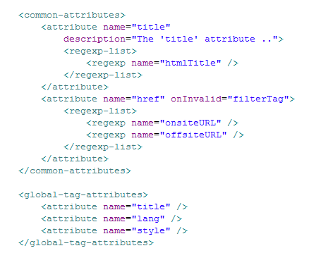
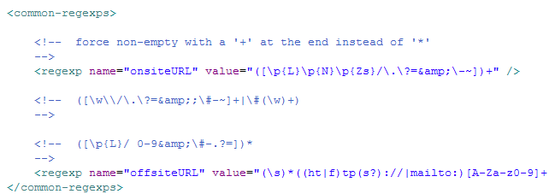
Dive to AntiSamy (3) - configuration

Slide 15
Dive to AntiSamy (4) - result
<div> </div>
<b> <p> samy is my hero</p> </b> <a href="http://www.google.com"> Google</a>
Notes:
Try this url: http://antisamysmoketest.com/go/attack, and select this policy file “antisamy-tinymce.xml”
And input the below content into the smoke test, and check the result☺
<body>
<div id="foo">
<img src="javascript:xss()">
</div>
<b><u>
<p style="expression(…) ">
samy is my hero</p>
</u></b>
<a href="http://www.google.com">
Google</a><script src="hax.js">
</script>

Slide 16
How can I start?
Definition
Think which tags and attributes you need
Define the regular expression to the allowed values
Configuration
Find the similar policy file sample
Coding
Very easy, refer to the next page
Modify it to meet your requirement

Slide 17
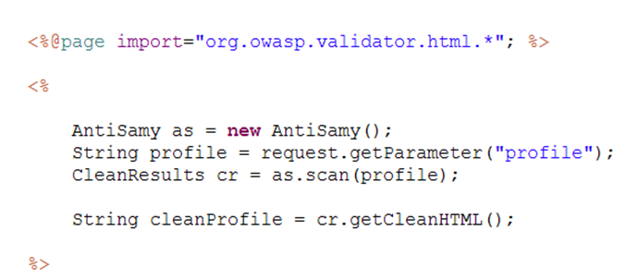

Very easy to code

Slide 18
Part 3
Case study

Slide 19
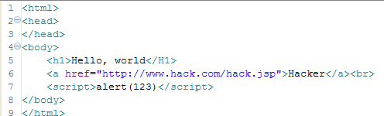
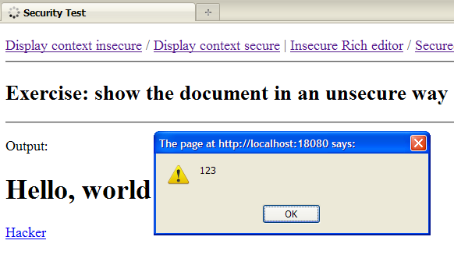
Case 1 – show html content
NO AntiSamy
Notes:
How to reproduce issue with the sample war?
Deploy the sample war to Tomcat(or any other App server)
Input this url: http://localhost:{port}/security/jsp/index.jsp
Then you can click “Display context insecure” and “Display context secure” to see the different output.

Slide 20
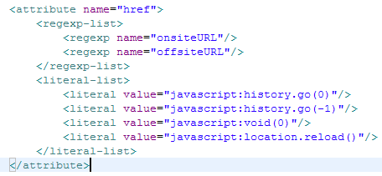
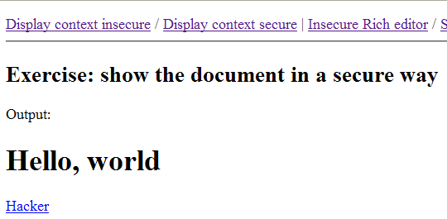
With AntiSamy,
remove script

Slide 21
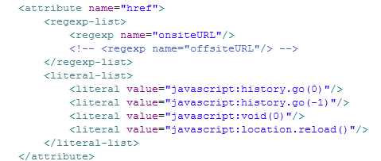
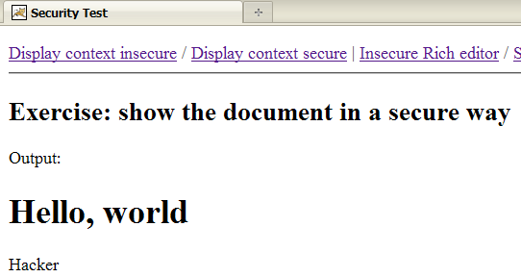
With AntiSamy,
Remove link

Slide 22
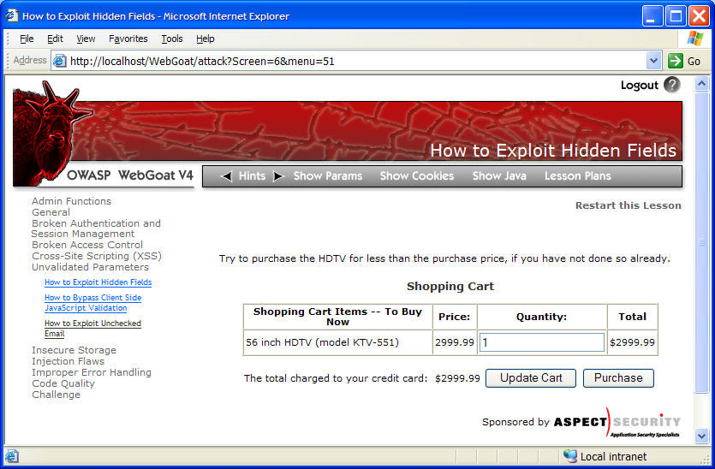

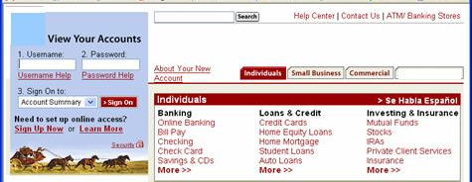

Case 2 – prevent CSRF
1
Attacker sets the trap on some website on the internet
(or simply via an e-mail)
Application with CSRF vulnerability
Hidden <img> tag contains attack against vulnerable site
Finance
Transactions
Accounts
Administration
Communication
Knowledge Mgmt
E-Commerce
Bus. Functions
2
While logged into vulnerable site,
victim views attacker site
Custom Code
3
Vulnerable site sees legitimate request from victim and performs the action requested
<img> tag loaded by browser – sends GET request (including credentials) to vulnerable site
Notes:
The img src can be like:
<img src="http://example.com/app/transferFunds?amount=1500&destinationAccount=attackersAcct#" width="0" height="0" />

Slide 23
General solution
Add a token to each protected resource(url) as a hidden parameter
Can leverage ESAPI
AntiSamy
Define the attribute value expression to href
As a result, all the offsite url will be removed.
Notes:
General solution to solve CSRF by ESAPI
Step 1. Generate new CSRF token and add it to user once on login and store user in http session.
This code should be executed when the user logs into the application. This is done in the default ESAPI implementation, and it is stored as a member variable of the User object that gets stored in the session.
//this code is in the DefaultUser implementation of ESAPI
/** This user's CSRF token. */
private String csrfToken = resetCSRFToken();
...
public String resetCSRFToken() {
csrfToken = ESAPI.randomizer().getRandomString(8, DefaultEncoder.CHAR_ALPHANUMERICS);
return csrfToken;
}
Step 2. On any forms or urls that should be protected, add the token as a parameter / hidden field.
The addCSRFToken method below should be called for any url that is going to be rendered that needs CSRF protection. Alternatively if you are creating a form, or have another technique of rendering URLs (like c:url), then be sure to add a parameter or hidden field with the name "ctoken" and the value of DefaultHTTPUtilities.getCSRFToken(). That should do the work of adding the data to the url or form. We'll validate it in the next step.
//from HTTPUtilitiles interface
final static String CSRF_TOKEN_NAME = "ctoken";
//this code is from the DefaultHTTPUtilities implementation in ESAPI
public String addCSRFToken(String href) {
User user = ESAPI.authenticator().getCurrentUser();
if (user.isAnonymous()) {
return href;
}
// if there are already parameters append with &, otherwise append with ?
String token = CSRF_TOKEN_NAME + "=" + user.getCSRFToken();
return href.indexOf( '?') != -1 ? href + "&" + token : href + "?" + token;
}
...
public String getCSRFToken() {
User user = ESAPI.authenticator().getCurrentUser();
if (user == null) return null;
return user.getCSRFToken();
}
Step 3. On the server side for those protected actions, check that the submitted token matches the token from the user object in the session. (Assuming you've implemented this properly, a failure constitutes a security issue.)
Ensure that you call this method from your servlet or struts action or jsf controller, or whatever server side mechanism you're using to handle requests. This should be called on any request that you need to validate for CSRF protection. Notice that when the tokens do not match, it's considered a possible forged request.
//this code is from the DefaultHTTPUtilities implementation in ESAPI
public void verifyCSRFToken(HttpServletRequest request) throws IntrusionException {
User user = ESAPI.authenticator().getCurrentUser();
// check if user authenticated with this request - no CSRF protection required
if( request.getAttribute(user.getCSRFToken()) != null ) {
return;
}
String token = request.getParameter(CSRF_TOKEN_NAME);
if ( !user.getCSRFToken().equals( token ) ) {
throw new IntrusionException("Authentication failed", "Possibly forged HTTP request without proper CSRF token detected");
}
}
Step 4. On logout and session timeout, the user object is removed from the session and the session destroyed.
In this step, logout is called. When that happens, note that the session is invalidated and the current user object is reset to be an anonymous user, thereby removing the reference to the current user and accordingly the csrf token.
//this code is in the DefaultUser implementation of ESAPI
public void logout() {
ESAPI.httpUtilities().killCookie( ESAPI.currentRequest(), ESAPI.currentResponse(), HTTPUtilities.REMEMBER_TOKEN_COOKIE_NAME );
HttpSession session = ESAPI.currentRequest().getSession(false);
if (session != null) {
removeSession(session);
session.invalidate();
}
ESAPI.httpUtilities().killCookie(ESAPI.currentRequest(), ESAPI.currentResponse(), "JSESSIONID");
loggedIn = false;
logger.info(Logger.SECURITY_SUCCESS, "Logout successful" );
ESAPI.authenticator().setCurrentUser(User.ANONYMOUS);
}

Slide 24
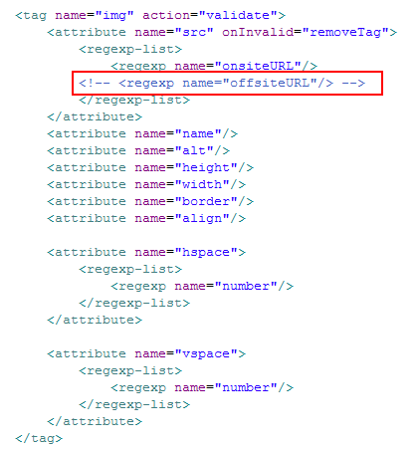
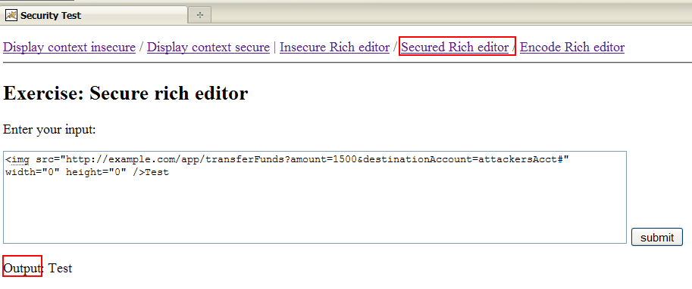
Remove offsite URL
Notes:
How to reproduce this issue with the sample war?
(1) Modify the antisamy-anythinggoes-1.4.3.xml file in the sample war
(2) Input this url in the browser: http://localhost:18080/security/jsp/RichEditorSecure.jsp, and input the below strings:
<img src="http://example.com/app/transferFunds?amount=1500&destinationAccount=attackersAcct#" width="0" height="0" />Test
(3) As a result, it will output “Test” – the img tag is removed based on the policy file.

Slide 25
Case 3 – Rich editor
Usability VS Security
We want to improve the usability to satisfy customer
We have to guarantee the application security

Slide 26
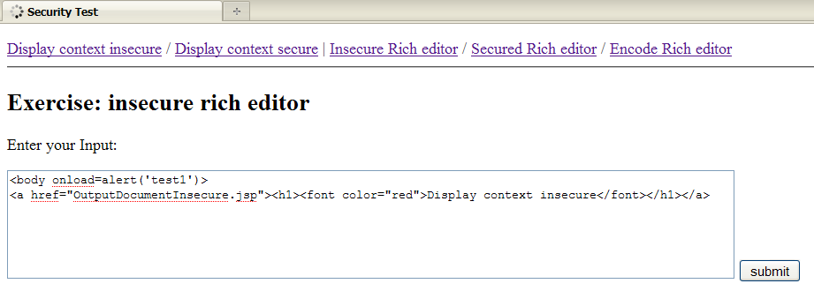
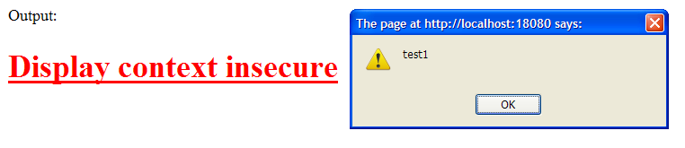
Directly output user’s input
Notes:
Input the below string:
<body onload=alert('test1')>
<a href="OutputDocumentInsecure.jsp"><h1><font color="red">Display context insecure</font></h1></a>

Slide 27
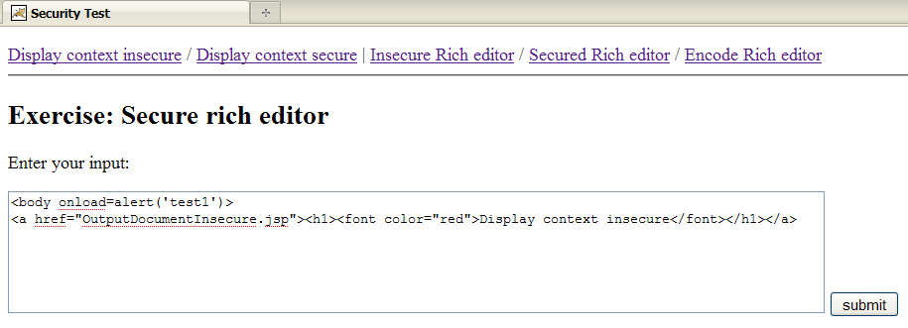
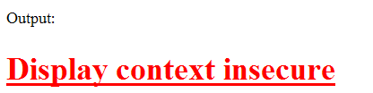
Use policy to filter the input

Slide 28
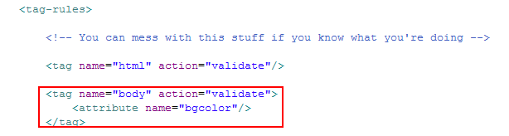
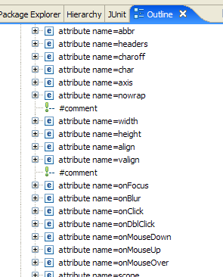
Policy file content

Slide 29
Part 4
Advanced topic

Slide 30
Topic 1 – XSS prevention
Modify / Keep / Break
AntiSamy
ESAPI
Stinger

Slide 31
AntiSamy
Use whitelist to get clean output
Remove some words to handle XSS
ESAPI
A set of security control acess
Use encode to handle XSS
Stinger
Use blacklist to validate the input
Break one rule, break the chain

Slide 32
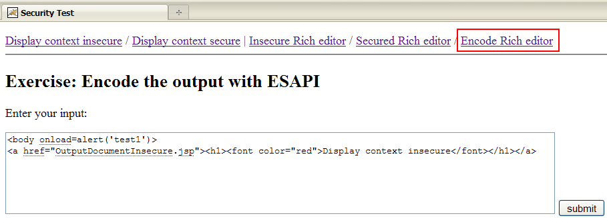
ESAPI encode
Use ESAPI to encode the input
Notes:
You may refer to this url for ESAPI: https://www.owasp.org/index.php/Esapi

Slide 33
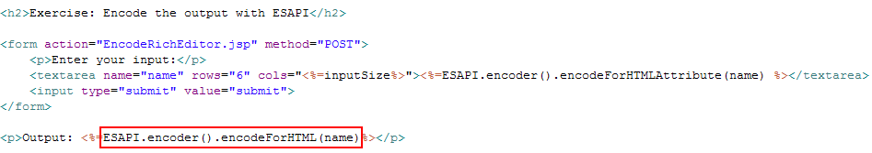
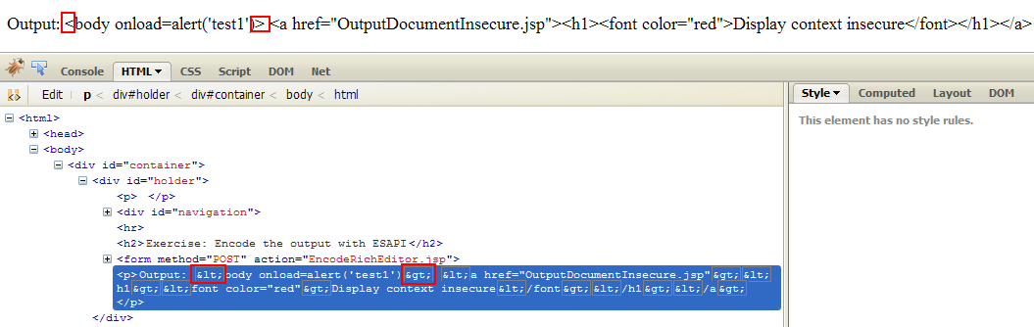
Java code and html code

Slide 34
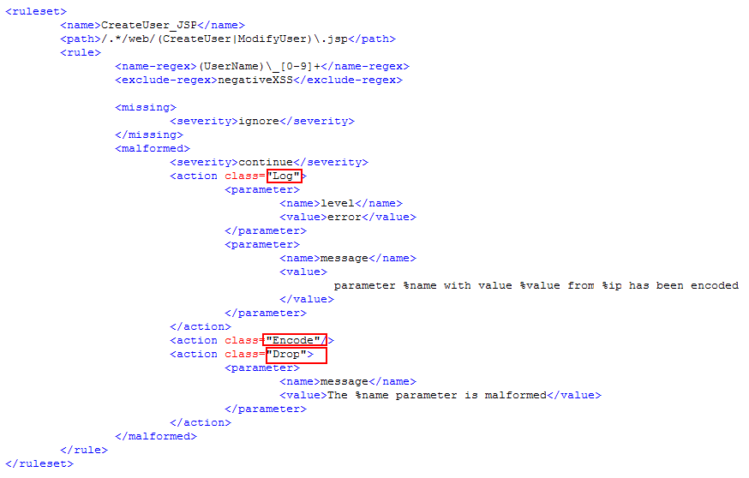
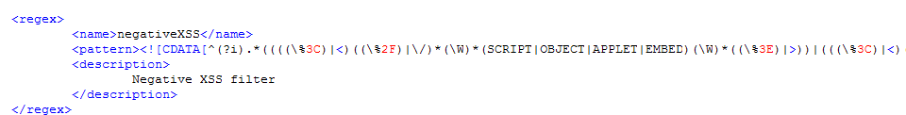
Stinger
Notes:
You may refer to this url for OWASP Stinger project: https://www.owasp.org/index.php/Category:OWASP_Stinger_Project\
Generally, we can define the stinger rule, and create one servlet filter to adapt this rule, so that to each request, these rules will make effective.

Slide 35

Topic 2 - Scrubb
Database scanning tool
Focus on stored XSS
BSD license

Slide 36
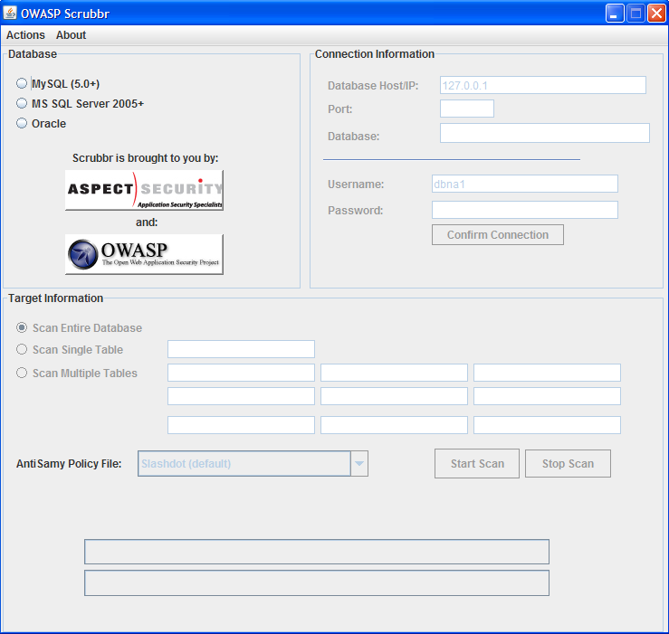

Slide 37

Summary
AntiSamy is used to get a clean HTML
Policy file
Typical use case for AntiSamy
Display the HTML file
Handle XSS
ESAPI encode
Security to rich editor
CSRF
AntiSamy
Stinger

Slide 38

Resources
OWASP China AntiSamy Java
http://www.owasp.org.cn/owasp-project/Projects/OWASP_AntiSamy_Java
OWASP AntiSamy Java
http://www.owasp.org/index.php/Category:OWASP_AntiSamy_Project
AntiSamy smoke test site
http://antisamysmoketest.com/go/attack
ESAPI
https://www.owasp.org/index.php/Esapi
XSS Cheat sheet
http://ha.ckers.org/xss.html

Slide 39

Questions?

