Slide 1
Realtime Transparent Traffic Monitoring using Windows Filtering Platform
用 WFP 进行实时透明的流量监控

Slide 2
自我介绍
李好 - ThoughtWorks 高级咨询师
ThoughtWorks 内建安全负责人，10+年系统编程经验，有多年大型电信和汽车行业微服务和 Devops 的经验，对操作系统和 web 安全有浓厚兴趣，在项目长期进行 DevSecOps 实践。希望能和有相同兴趣的朋友们交流。

Slide 3
介绍 Windows Filtering Platform

Slide 4
WFP 是什么？能做什么？
WFP 提供了一套 API 来实现阻塞，过滤，修改或者加固网络流量，替换了 Windows XP 时代流行的 TDI & NDIS filtering 方案
防火墙
杀毒软件
流量检查 (家长控制)
网络问题排错
….

Slide 5
支持的操作系统
Windows Vista 起支持三层过滤
Windows 7 起支持流量转发
Windows 8 & Server 2012 开始支持二层和vSwitch过滤

Slide 6
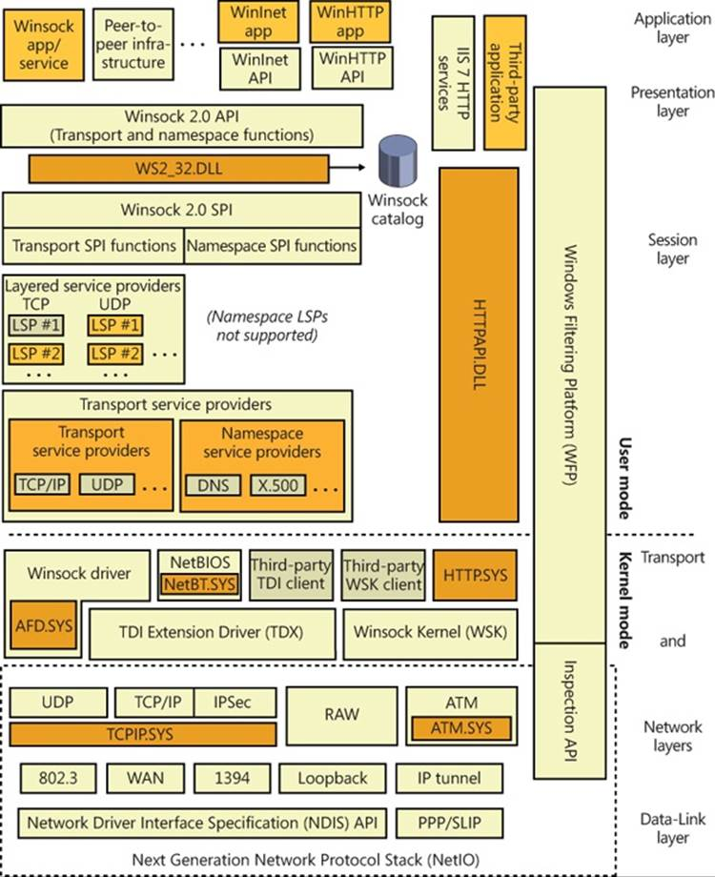
Windows 网络协议栈

Slide 7
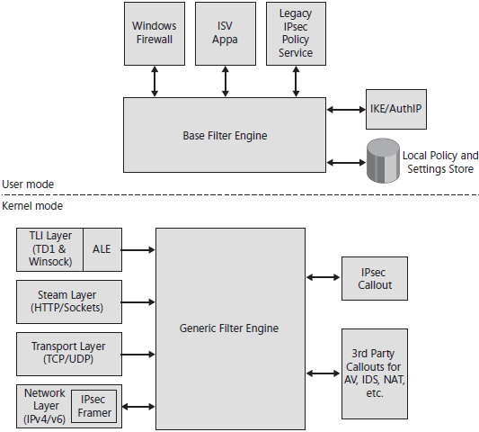
WFP 架构
Base Filter Engine - 用户态过滤引擎
Generic Filter Engine (netio.sys) - 内核态过滤引擎
Callout Driver - 第三方驱动程序

Slide 8
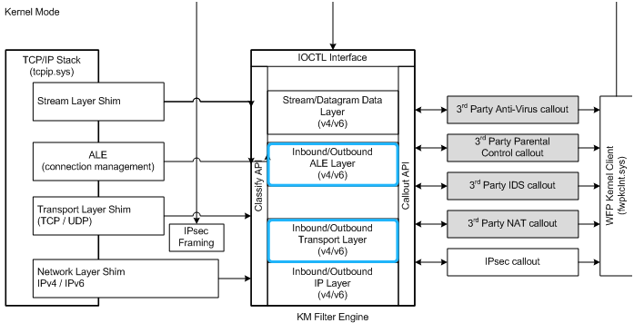
WFP 内核态架构

Slide 9
Callout 驱动
通过编写 Callout 驱动来扩展 WFP 的功能
Callout 函数
A notifyFn function to process notifications.
A classifyFn function to process classifications.
A flowDeleteFn function to process flow deletions (optional).
GUID, unique id for a callout

Slide 10
过滤器
过滤器是一种数据结构，它定义了一系列的规则(rules)和当规则满足时的动作(action)。过滤器被注册到过滤引擎里面。一旦注册，过滤器就要对匹配的流量进行处理了。
Filter condition (FWPM_FILTER_CONDITION0)
Filter action (FWPM_ACTION0)

Slide 11
注册 Callout 和 过滤器
Create a WFP session FwpmEngineOpen
Start the registering transaction FwpmTransactionBegin
Register the callout FwpsCalloutRegister
Add the callout to the engine FwpmCalloutAdd
Add the filter FwpmFilterAdd
Add the sublayer FwpmSubLayerAdd
Finish the registering by FwpmTransactionCommit & FwpmEngineClose

Slide 12
Callout 函数
Classify function:
FWPS_CALLOUT_CLASSIFY_FN FwpsCalloutClassifyFn; void FwpsCalloutClassifyFn( const FWPS_INCOMING_VALUES *inFixedValues, // address, port, const FWPS_INCOMING_METADATA_VALUES *inMetaValues, // meta data e.g. pid void *layerData, // layer data, e.g. NET_BUFFER_LIST, PACKET_DATA const FWPS_FILTER0 *filter, UINT64 flowContext, // context from other layer FWPS_CLASSIFY_OUT *classifyOut // out decision ) {...}

Slide 13
WFP 中 TCP 握手的生命周期
TCP -- Client:
bind: FWPM_LAYER_ALE_BIND_REDIRECT_V4
bind: FWPM_LAYER_ALE_RESOURCE_ASSIGNMENT_V4
connect: FWPM_LAYER_ALE_CONNECT_REDIRECT_V4
connect: FWPM_LAYER_ALE_AUTH_CONNECT_V4
Send SYN ==>
SYN: FWPM_LAYER_OUTBOUND_TRANSPORT_V4
SYN: FWPM_LAYER_OUTBOUND_IPPACKET_V4
Recv SYN-ACK <==
SYN-ACK: FWPM_LAYER_INBOUND_IPPACKET_V4
SYN-ACK: FWPM_LAYER_INBOUND_TRANSPORT_V4
FWPM_LAYER_ALE_FLOW_ESTABLISHED_V4
Send ACK <==
ACK: FWPM_LAYER_OUTBOUND_TRANSPORT_V4
ACK: FWPM_LAYER_OUTBOUND_IPPACKET_V4

Slide 14
WFP 中 TCP 握手的生命周期
TCP -- Server:
bind: FWPM_LAYER_ALE_BIND_REDIRECT_V4
bind: FWPM_LAYER_ALE_RESOURCE_ASSIGNMENT_V4
listen: FWPM_LAYER_ALE_AUTH_LISTEN_V4
Accept SYN <==
SYN: FWPM_LAYER_INBOUND_IPPACKET_V4
SYN: FWPM_LAYER_INBOUND_TRANSPORT_V4
SYN: FWPM_LAYER_ALE_AUTH_RECV_ACCEPT_V4
Send SYN-ACK ==>
SYN-ACK: FWPM_LAYER_OUTBOUND_TRANSPORT_V4
SYN-ACK: FWPM_LAYER_OUTBOUND_IPPACKET_V4
Recv ACK <==
ACK: FWPM_LAYER_INBOUND_IPPACKET_V4
ACK: FWPM_LAYER_INBOUND_TRANSPORT_V4
FWPM_LAYER_ALE_FLOW_ESTABLISHED_V4

Slide 15
WFP 的 Layer
FWPM_LAYER_ALE_AUTH_CONNECT_V4 - start connecting (the SYN packet)
FWPM_LAYER_ALE_CONNECT_REDIRECT_V4 - suitable for changing destination
FWPM_LAYER_ALE_AUTH_RECV_ACCEPT_V4 - accept the incoming connection (incoming SYN)
FWPM_LAYER_OUTBOUND_TRANSPORT_V4 - all outbound transport packets (e.g. TCP)
FWPM_LAYER_INBOUND_TRANSPORT_V4 - all inbound transport packets
…...

Slide 16
参考
WFPStarterKit https://github.com/JaredWright/WFPStarterKit
Windows Internal 6th Chapter 7
MSN Messenger Monitor sample https://github.com/Microsoft/Windows-driver-samples/tree/master/network/trans/msnmntr
Traffic Inspection sample https://github.com/Microsoft/Windows-driver-samples/tree/master/network/trans/inspect
WinDbg extension for analyzing traffic of the virtual machines https://github.com/isciurus/windbgshark
Benchmarking Windows Packet-Capture Methods for Windows Driver Development
Comparison of User Mode and Kernel Mode Applications for Modifying HTTP Traffic

Slide 17
Thanks
Q&A
haoli@thoughtworks.com

